Slide 1




DIGITAL IMAGE PROCESSING PROJECT
LICENSE PLATE RECOGNITION SYSTEM

Slide 2

OUR TEAM
Haider Ali Kayani
Laiba Shafqat

Slide 3
INTRODUCTION
Using the power of Digital Image Processing, this project delves into the world of License Plate Recognition. Our system employs several techniques - grayscale conversion, edge detection, contour analysis, and OCR - to detect and extract license plate information from images.

Slide 4

PROJECT OVERVIEW AND PROCESS
Using Python's OpenCV library and EasyOCR, this project encompasses a multi-stage process. Initially, the image undergoes preprocessing steps, including conversion to grayscale, edge detection using the Canny algorithm, and contour identification. These steps pave the way for localization of the license plate within the image.
Then, the system applies a mask to isolate the license plate area, followed by cropping to extract the plate's content. Employing EasyOCR, text recognition is performed on this cropped section, allowing for the retrieval of plate information. The final output is an enhanced image, annotated with the recognized license plate characters.

Slide 5
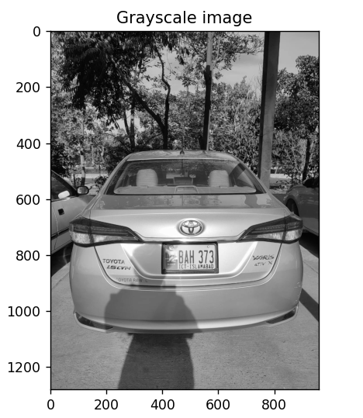
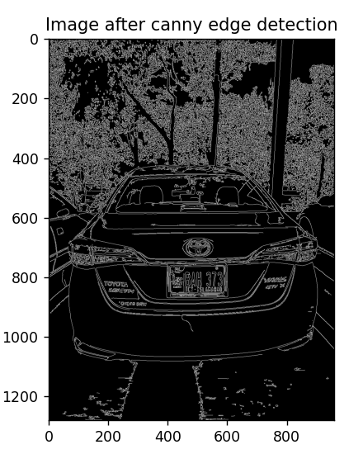
RESULT

Slide 6
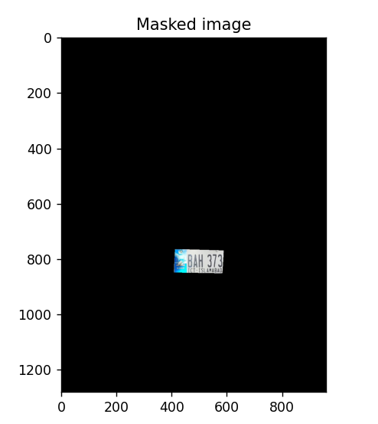
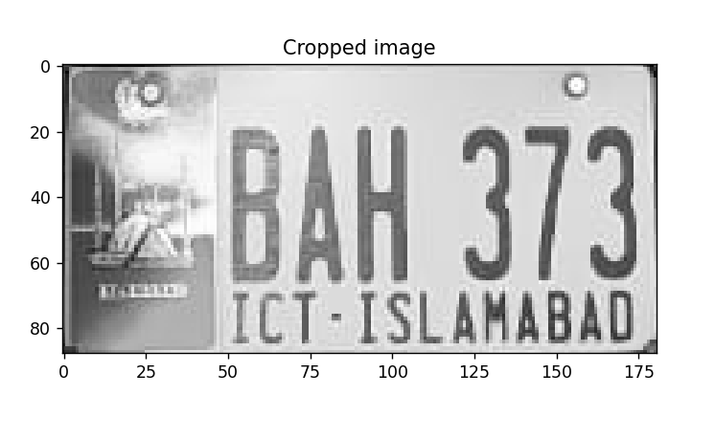
RESULT

Slide 7
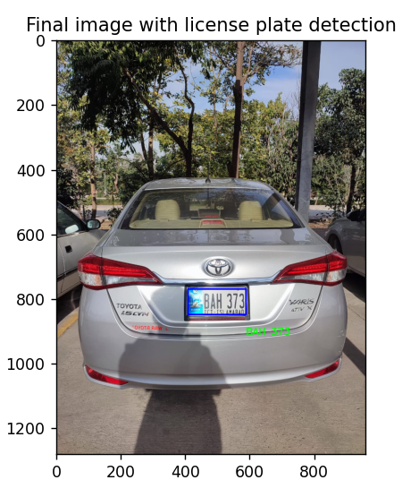
RESULT

Slide 8
CONCLUSION
Our exploration into License Plate Recognition showcases the power of computer vision techniques. This project demonstrates the effectiveness of automating plate identification using advanced algorithms. With numerous applications, this technology highlights the potential for innovation.

Slide 9
THANK YOU

